Slide 1

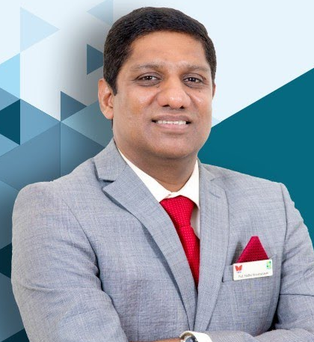
Co-hosted Seminar on COVID-19
It is hard to imagine a time of such uncertainty and change. As the virus sweeps all four corners of the Earth, it leaves behind societies, businesses and individual lives needing to be rebuilt. In this co-hosted seminar between Southampton Business School (UK) and TAPMI (India), we consider perspectives on how organisations need to respond to the greatest challenge in living memory.
Back to Business
Navigating the pandemic and its aftermath
Invited Speakers
Creating & Maintaining Organizational Value in Times of Crisis
Paurav Shukla, Professor of Marketing,
University of Southampton
Re-imagining Management Education Post COVID-19
Prof. Madhu Veeraraghavan, Director and T.A. Pai Chair Professor of Finance,
T.A. Pai Management Institute (TAPMI)
Monday 22nd June 2020
09.30-11.00am (BST), 14.00-15.30 (IST)
Please sign up via the Zoom link:
bit.ly/uos-tapmi

